Slide 1
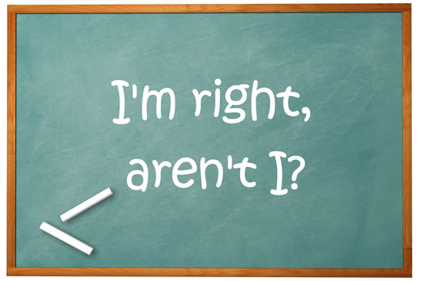
Elektronická učebnice - II. stupeň Základní škola Děčín VI, Na Stráni 879/2 – příspěvková organizace Anglický jazyk
35.1 Question tags (Tázací dovětky)
You can study for example this
Autor: Mgr. Michaela Kaplanová

Slide 2
Elektronická učebnice - II. stupeň Základní škola Děčín VI, Na Stráni 879/2 – příspěvková organizace Anglický jazyk
35.2 What do we already know?
We can form the questions
We know the auxiliary verbs (be, do, have)
We can use the personal pronouns
Are we…? | Have you…?
Will you…? | Is she…?
Does he…? | Has she…?
verbs | be | do | have
possible positive forms | am, is, are was, were | do, does did | have, has had
I | we
you | you
he, she, it | they

Slide 3
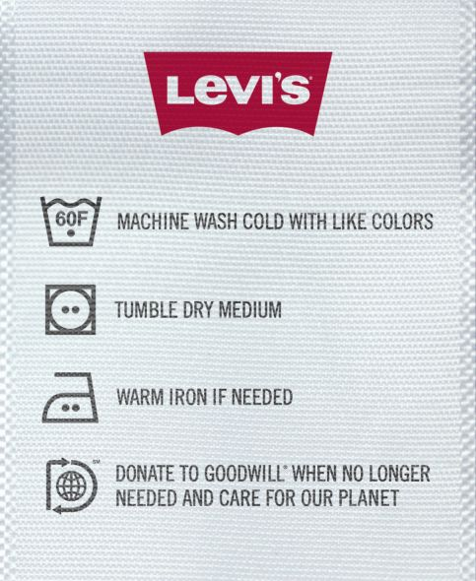
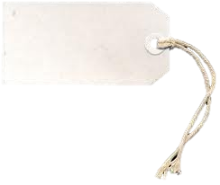
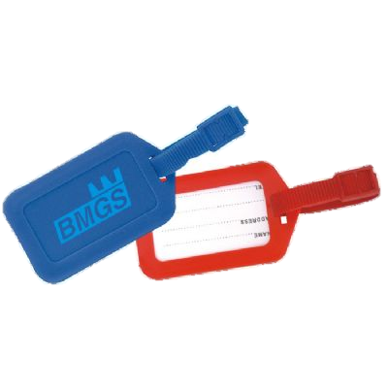
Elektronická učebnice - II. stupeň Základní škola Děčín VI, Na Stráni 879/2 – příspěvková organizace Anglický jazyk
35.3 New terms
Tag – štítek, visačka
Auxiliary verb – pomocné sloveso
Confirmation – potvrzení
Rising – stoupající
Falling – klesající
Intonation – intonace
To be sure – být si jistý
A tag is usually something small that gives us
some extra information.

Slide 4
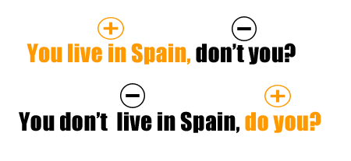
Elektronická učebnice - II. stupeň Základní škola Děčín VI, Na Stráni 879/2 – příspěvková organizace Anglický jazyk
35.4 Question tags
We use the question tags in spoken English to ask for confirmation. The answer is not always expected.
Form
With affirmative statement, we use a negative question tag.
With negative statement, we use an affirmative question tag.
The tense is the same in both parts.
The subject is replaced by the subject pronoun in the question tag.
Affirmative sentences | Negative sentences
She is Spanish, isn´t she? | They saw him, didn´t they? | She isn´t Spanish, is she? | They didn´t see him, did they?
You´ve got it, haven´t you | You´ve done it, haven´t you? | You haven´t got it, have you? | You haven´t done it, have you?
He plays golf, doesn´t he? | They can sing, can´t they? | He doesn´t play golf, does he? | They can´t sing, can they?
She was there, wasn´t she? | She will be OK, won´t she? | She wasn´t there, was she? | She won´t be ok, will she?
You were at home, weren´t you? | You are a pilot, aren´t you? | You weren´t at home, were you? | You aren´t a pilot, are you?
REMEMBER: I am your friend, aren´t I?

Slide 5
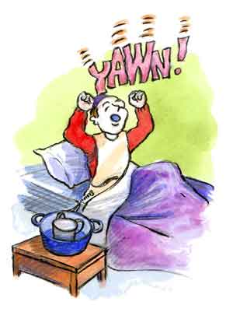
Elektronická učebnice - II. stupeň Základní škola Děčín VI, Na Stráni 879/2 – příspěvková organizace Anglický jazyk
35.5 Exercises Fill in the correct question tag:
The purse was very expensive, _____________________ ?
You like your teacher, _____________________ ?
Dan can fix it, _____________________ ?
We will go there, _____________________ ?
Your parents have seen the movie, _____________________ ?
The kids are at school, _____________________ ?
Your sister has got the money, _____________________ ?
You don´t like getting up early, _____________________ ?
You won´t leave now, _____________________ ?
The twins know you, _____________________ ?
Write the statement before the question tag:
__________________________, is it?
__________________________, were you?
__________________________, did she?
__________________________, can´t he?
__________________________, have they?

Slide 6
Elektronická učebnice - II. stupeň Základní škola Děčín VI, Na Stráni 879/2 – příspěvková organizace Anglický jazyk
35.6 Something more difficult - INTONATION
When we use falling intonation in a question tag,
we already know the answer, we are sure.
e.g.
You can´t speak Italian, can you? (The speaker knows that he/she can´t.)
When we use rising intonation in a question tag,
we are not sure, we are really asking.
e.g.
You are not his brother, are you?
(The speaker doesn´t know whether he is or not.)

Slide 7
Elektronická učebnice - II. stupeň Základní škola Děčín VI, Na Stráni 879/2 – příspěvková organizace Anglický jazyk
35.7 CLIL
Now you know how to form the question tags in English. Is there something similar in the Czech language? Do you know some similar Czech phrases?
Look at the part of the song A LITTLE TIME by The Beautiful South and find the examples of the question tags.
I need a little time To think it over I need a little space Just on my own I need a little time To find my freedom I need a little... Funny how quick the milk turns sour Isn't it, isn't it Your face has been looking like that for hours Hasn't it, hasn't it Promises, promises turn to dust Wedding bells just turn to rust Trust into mistrust
You need a little room for your big head Don't you, don't you You need a little space for a thousand beds Won't you, won't you Lips that promise - fear the worst Tongue so sharp - the bubble burst Just into unjust
You had a little time And you had a little fun Didn't you, didn't you While you had yours Do you think I had none Do you, do you
You find this song here

Slide 8
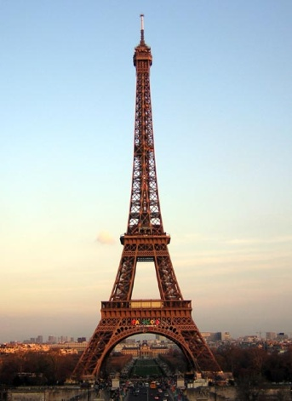
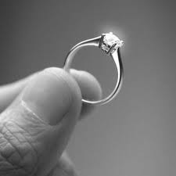
Elektronická učebnice - II. stupeň Základní škola Děčín VI, Na Stráni 879/2 – příspěvková organizace Anglický jazyk
35.8 Test Find the correct question tag:
You did your best,…
don´t you?
didn´t you?
you don´t?
you didn´t?
2. Your class teacher is young,…
isn´t she?
is she?
was she?
wasn´t she?
3. Your parents have been to Paris,…
weren´t they?
hadn´t they?
haven´t they?
were they?
4. You will marry her,…
wouldn´t you?
would you?
will you?
won´t you?
Correct answers: 1b, 2a, 3c, 4d

Slide 9
Elektronická učebnice - II. stupeň Základní škola Děčín VI, Na Stráni 879/2 – příspěvková organizace Anglický jazyk
35.9 Použité zdroje, citace
http://thecrazyteacherblog.blogspot.com/2011/02/about-question-tags.html
http://planetforward.ca/blog/levis-and-goodwill-launch-an-eco-friendly-tag-for-change/
http://www.easyelements.com/paper-textures.html
http://www.editorsweblog.org/newspaper/2011/11/journalism_the_good_the_bad_and_the_mone.php
http://uberdelight.blogspot.com/2011/06/up-stars-elizabeth-olsen.html
http://julieslymediseasefight.blogspot.com/2011/05/up-and-down-up-and-down-up-and-down.html
http://eil.com/shop/moreinfo.asp?catalogid=81492

Slide 10
Elektronická učebnice - II. stupeň Základní škola Děčín VI, Na Stráni 879/2 – příspěvková organizace Anglický jazyk
35.10 Anotace
Autor | Mgr. Michaela Kaplanová
Období | 07 – 12/2011
Ročník | 9. ročník
Klíčová slova | Tag, auxiliary verb, confirmation, rising, falling, intonation
Anotace | Prezentace popisující tvoření a použití tázacího dovětku

